Slide 1
Section 5.2
Solving Rational Expressions

Slide 2
Solving Rational Expressions:
“Solving” an equation means finding all the values of the variable such that both sides of an equation are equal
“Solving” is not “simplifying”[reducing an equation]
When solving a rational equation, eliminate your denominators by multiplying all terms by the LCD

Slide 3
Steps to Solving Rational Equations
When Solving Rational Equations:
  There will always be an equal sign somewhere in the middle when solving an equation, as opposed to simplifying [no equal sign]
  The goal is to find a value for “x” so that both sides of the equation will be equal when you plug it back in
  To make the equation easier to solve, find the LCD, multiply all terms by the LCD to cancel out all the denominators: NOTE: You can only do this when you are SOLVING!! NOT Simplifying!!
  Make sure to find your NPV’s, if your answer is equal to an NPV then it’s not an answer, it will be called an “Extraneous Root”

Slide 4
Practice: Solve for “x”

Slide 5
LCD:
NPV
LCD:
NPV
Check:

Slide 6
LCD:
NPV
LCD:
Make sure you remember the plus or minus sign!!!

Slide 7
Find the NPV:
Find the LCD:
The solution is not the same as the NPV

Slide 8
II) Equations with Extraneous Solutions , No Solutions, AND INFINITE Solutions!!
If you get an answer that is the same as the NPV, then it is not an answer and is an extraneous root
If all the x’s are cancelled out and both sides are NOT equal → There are NO solutions!!
If all the x’s are cancelled out and both sides are EQUAL → You have infinite solutions! “x” can be anything and both sides will always equal
The best way to identify these situations is to simplify your equation as much as possible before solving
Below are two formulas that can help :

Slide 9
Below are equations with no solutions that can be solved in multiple ways:
2nd method: simplify first!
1st method: step by step algebra
The denominators are the same, so cancel them out
All the x’s are gone, both sides are not equal, therefore we have
“NO SOLUTIONS”!
Your answer is the same as the NPV, so it’s an extraneous root.
No solutions!!
Q: What would our answer be
if this number was a “6”?

Slide 10
Practice: Solve for “x”. Indicate if there are No Solutions, Infinite Solutions, or only one solution:

Slide 11
No Solutions because
both sides are not equal!!
Both sides are exactly equal
No matter what the value of “x”
is, both sides are always the same
Solution will be all real numbers

Slide 12
The terms in the binomial are switched
Find the NPV:
Find the LCD:
There are no variables left
and both sides are NOT equal
The solution is the same as the extraneous root, so, no solutions
Answer will be no real solutions

Slide 13
Q:Which of the following equations have an extraneous root?

Slide 14
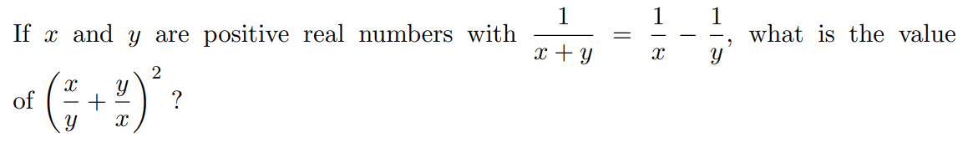
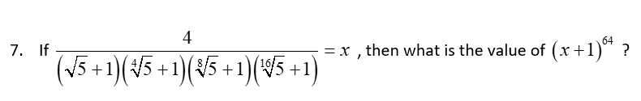
Ex: For what values of “x” will the inequality be true?
Ex: For what values of “x” will the inequality be true?

Slide 15
Answer: 625

Slide 16
For what values of “x” will the inequality be true?

Slide 17
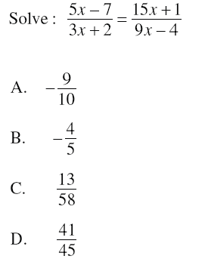
Find the NPV:
Find the LCD:

Slide 18
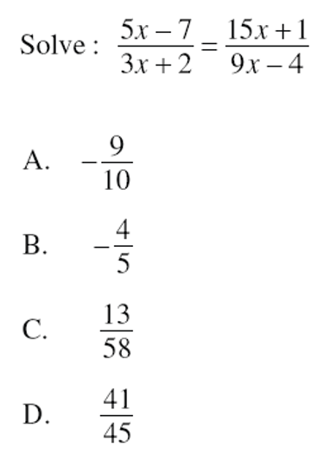
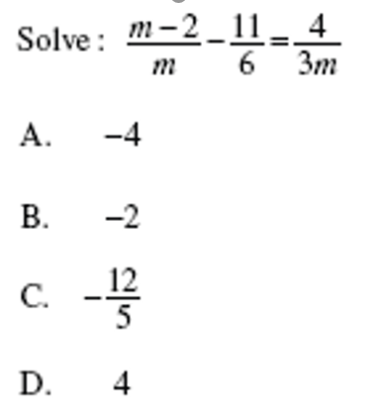

Slide 19
